Slide 1
Stochastic Methods in Credit Risk Modelling, Valuation and Hedging
Introduction to Credit Risk and Credit Derivatives
Tomasz R. Bielecki
Northeastern Illinois University
t-bielecki@neiu.edu
In collaboration with Marek Rutkowski

Slide 2
Part 1: Portfolio Credit Risk
Measuring credit risk.
Portfolio analysis.
CVaR models.
CreditMetrics.
CreditGrades.
Counterparty credit risk.
Reference credit risk.

Slide 3
Part 2: Credit Derivatives
Counterparty credit risk.
Reference credit risk.
Classification of credit derivatives.
Total return swaps.
Credit default swaps.
Spread linked swaps.
Credit options.

Slide 4
Part 3: Mathematical Modelling
Merton’s model of corporate debt.
Black and Cox approach.
Intensity-based approach to credit risk.
Hybrid models.
Implied probabilities of default.
Markov models of credit ratings.
Market risk and term structure models.

Slide 5
Credit Risk: Modelling, Valuation and Hedging
Part 1: Portfolio Credit Risk
The central point is the quantitative estimate of the amount of economic capital needed to support a bank´s risk-taking activities

Slide 6
Measuring Credit Risk
Credit risk models should capture:
  Systematic vs Idiosyncratic Risk Sources
  Credit spread risk,
  Downgrade risk (credit rating),
  Default risk (default probability),
  Recovery rate risk (recovery rate),
  Exposure at default (loss given default),
  Portfolio diversification (correlation risk),
  Historical Probabilities vs Risk-Neutral Probabilities.

Slide 7
Portfolio Analysis I
What is really important:
  Concentration risk, Basle Committee 25% rule; Herfindahl-Hirshman Index
  Diversification effect,
  Rating structure,
  CVaR, Credit Value-at-Risk
  Risk-adjusted performance measures,
  Capital optimisation,
  Sensitivity and stress test analysis.

Slide 8
Portfolio Analysis II
Important questions to risk managers:
How should we define and measure credit risk of a portfolio of loans or bonds?
What are the measures of capital profitability the bank should apply?
What is the risk-return profile of the bank’s credit portfolio?
What is the capital amount required for the assumed rating of the bank’s credit portfolio?

Slide 9
Portfolio Analysis III
Which credit exposures represent the highest risk-adjusted profitability?
What are the main factors affecting the bank’s credit portfolio risk-adjusted profitability?
What are the main sources of the bank’s credit risk concentration and diversification?
How can the bank improve it’s portfolio profitability?

Slide 10
CVaR Models I
Types of Credit Risk Models:
  Risk aggregation:
    - Top-down, Aggregate risk in consumer, credit card, etc., portfolios;
    default rates for entire portfolios
    - Bottom-up, Individual asset level; default rates for individual obligors.
  Systemic factors recognition:
    - Conditional,
    - Unconditional.
  Default measurement:
    - Default mode, Two modes: default or no-default
    - Mark-to-market (model), Credit migrations accounted for.

Slide 11
CVaR Models II
Currently proposed industry sponsored CVaR models:
  CreditMetrics (RiskMetrics),
  CreditGrades (RiskMetrics),
  Credit Monitor/EDF (KMV/Moody’s),
  CreditRisk+ (Credit Suisse FB),
  CreditPortfolioView (McKinsey).

Slide 12
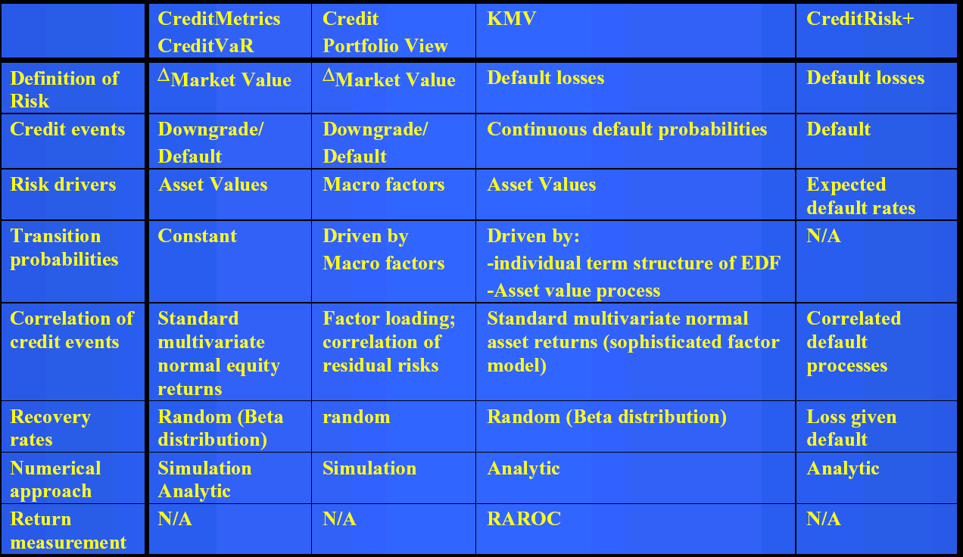
CVaR Models III

Slide 13
CreditMetrics I
A tool for assessing portfolio risk due to changes in debt value caused by changes in obligor credit quality.
Changes in value caused not only by possible default events, but also by upgrades and downgrades in credit quality are included.
The value-at-risk (VaR) - the volatility of value, not just the expected losses, is assessed.

Slide 14
CreditMetrics II
Risk is assessed within the full context of a portfolio. The correlation of credit quality moves across obligors is addressed. This allows to directly calculate the diversification benefits.
Value changes are relatively small with minor up(down)grades, but could be substantial if
there is a default (rare event).
This is far from the more normally distributed market risks that VaR models typically address.

Slide 15
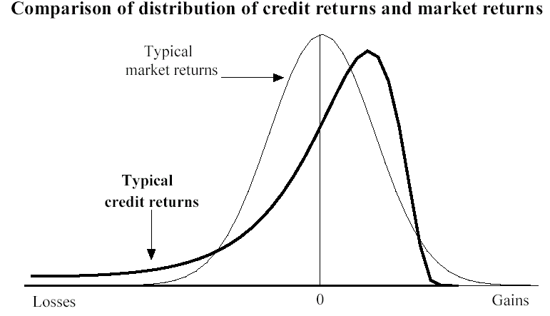
CreditMetrics III

Slide 16
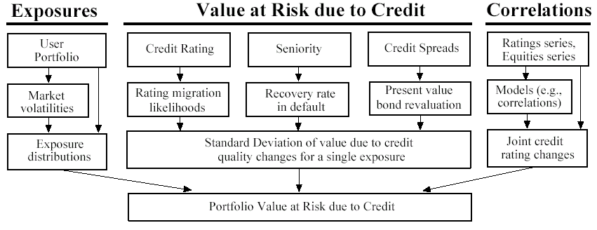
CreditMetrics IV

Slide 17
CreditGrades I
Is meant to provide a simple framework linking the credit risk and equity markets (a first-passage-time model).
Tracks the risk-neutral default probabilities.
Based on the ideas of the structural approach, due to Merton (1973), Black and Cox (1976).
Main deficiency are artificially low short-term credit spreads. CreditGrades corrects this by taking random default barrier and recovery rate.
This is essentially a pricing model

Slide 18
CreditGrades II
Asset value V follows a lognormal proces with
a constant volatility (under real-world probability).
Default occurs at the first crossing of the default barrier by V.
Default barrier is the product of the expected global recovery of the firm’s liabilities and the current debt per share of the firm.
The CreditGrade is the model-implied 5-year credit spread.

Slide 19
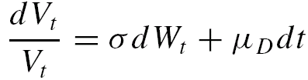
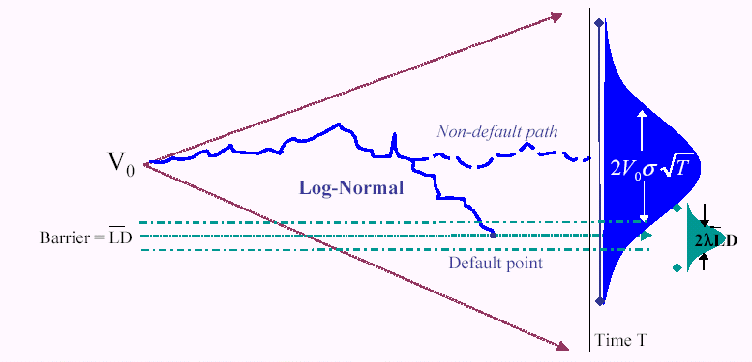
CreditGrades III

Slide 20
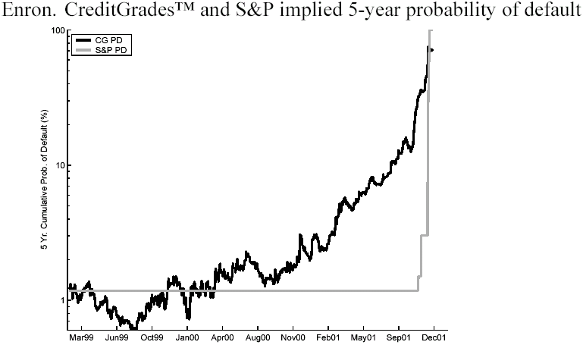
CreditGrades: Case Study

Slide 21
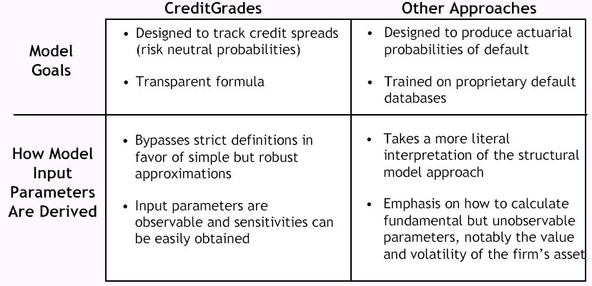
CreditGrades: Spin Summary

Slide 22
CreditGrades: No Spin Critique
CG appears to mix statistical and risk neutral probabilities.
CG assumes no-drift condition for asset value process, which appears to be unjustified.
Transparent formulae for probabilities of default resulting in CG framework and, apparently, relying on market observables only, appear to be founded on questionable (in general) relationship between volatility of equity and volatility of the asset value process.

Slide 23
Credit Monitor I
Credit Monitor provides M-KMV’s EDF credit measures on corporate and financial firms globally, updated on a monthly basis with up to five years of historical EDF information.
EDF (expected default frequency) is a forward looking measure of actual probability of default. EDF is firm specific.
Credit Monitor model follows the structural approach to calculate EDF’s. [The credit risk is driven by the firm’s value process.]

Slide 24
Credit Monitor II
Credit Monitor deals with firms whose equities are publicly traded. The market information contained in the firm’s stock price and the balance sheet is mapped to the firm’s EDF.
Credit Monitor used in M-KVM’s Portfolio Manager

Slide 25
CreditRisk+ I
An approach focused only on default event; it ignores migration and market risk.
For a large number of obligors, the number of defaults during a given period has a Poisson distribution. The loss distribution of a bond/loan portfolio is derived.
Belongs to the class of intensity-based (or reduced-form) models. Default risk is not linked to the capital structure of the firm.

Slide 26
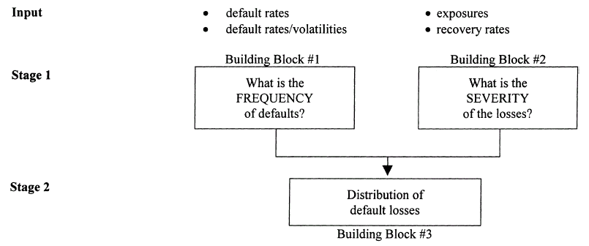
CreditRisk+ II

Slide 27
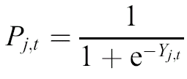
CreditPortfolioView
A multifactor model focused on the simulation of the joint distribution of default and migration probabilities for various rating groups.
Default/migration probabilities are linked to the state of the economy through macroeconomic factors (an econometric model).
Conditional probabilities of default are modelled as a logit function of the index:

Slide 28
Credit Risk: Modelling, Valuation and Hedging
Part 2: Credit Derivatives
The central points are providing protection against credit risk and diversification of credit risk exposure

Slide 29
Counterparty Credit Risk
Derivatives trading generates exposure to
the credit risk of the counterparty involved in
a given contract (typical examples: bonds, vulnerable options, defaultable swaps).
Counterparty credit risk is a function of:
  Creditworthiness of the counterparty,
  Size of profits accrued yet unrealised,
  Ability to use legally binding netting agreements.

Slide 30
Reference Credit Risk
Credit derivatives are privately held negotiable bilateral contracts that allow users to manage their exposure to credit risk, so-called reference credit risk.
Credit derivatives are financial assets like forward contracts, swaps and options for which the price is driven by the credit risk of economic agents (private investors or governments).

Slide 31
Why Credit Derivatives?
Credit derivatives connect the different fixed-income markets by being the “clearing-house” for credit risk transfer.
Insurance against credit events to reduce borrowing costs.
Diversification of exposure by means of synthetic loans.
Assume positions in markets that might otherwise be inaccessible.
Accounting and tax advantages.

Slide 32
Default Protection
Default protection:
Suppose a bank concerned that one of its customers may not be able to repay a loan.
The bank can protect itself against loss by transferring the credit risk to another party, while keeping the loan on its books.
Useful links: www.defaultrisk.com
www.margrabe.com

Slide 33
Special Features
Pay-out typically based on extremal event (for instance, the default event).
Limited liquidity (currently).
Insurance components may require actuarial analysis (under statistical probability).
Operational risk management important - can’t buy perfect insurance, and tail events are extremal (Bankers Trust)

Slide 34
A Simplified Taxonomy
Credit derivatives are usually rather involved.
They can be divided into three basic classes:
  Swaps:
    - Total rate of return swap, default swap, and spread-linked swap.
  Notes:
    - Default note, spread-linked note, and levered notes.
  Options:
    - Price, spread, and default options.

Slide 35
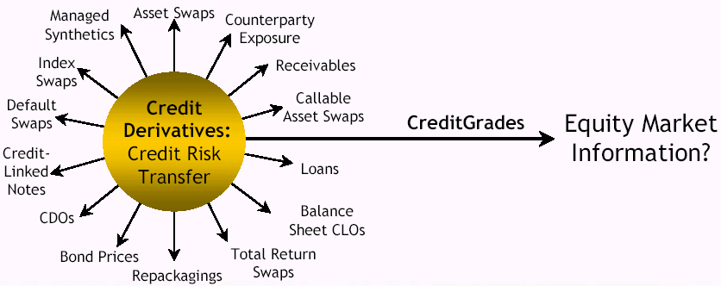
Spectrum

Slide 36
Vanilla Credit Derivatives
Total return (or asset) swap - TRS,
Credit-linked note - CLN,
Credit default swap (or option) - CDS,
Securitized pool (of corporates) - CDO,
Option on a corporate bond,
Credit spread swap (or option),
Insured cash-flow stream (swap guarantee).

Slide 37
Total Return Swap I
Asset Total Return
Party A
Party B
Floating Payments
Underlying assets may be bonds, loans, or other credit instruments. Permits the separation of asset ownership
and economic exposure: balance sheet rental or
out-sourcing, for example.

Slide 38
Total Return Swap II
Total Rate of Return Swap is a derivative contract that simulates the purchase of an instrument (note, bond, share, etc.) with 100% financing, typically floating rate.
The contract may be marked to market at each reset date, with the total return receiver receiving (paying) any increase in value of the underlying instrument, and the total return payer receiving (paying) any decrease in the value of the underlying instrument.

Slide 39
Credit Default Swap I
Default Premium
Party A
Party B
Recovery (after default)
Recovery is paid only if there is a default, so this is a “pure” credit risk product. That is, price and spread
risk is stripped away. B’s exposure is like that of an off-balance sheet loan.

Slide 40
Credit Default Swap II
Credit default swap is a contract between a buyer and a seller of protection, in which:
(a) the buyer of protection pays the seller a fixed, regular fee,
(b) the seller of protection provides the buyer with a contingent exchange that occurs either at the maturity of the underlying instrument or at the swap's date of early termination. The trigger event for the contingent payoff is a defined credit event (a default on the underlying instrument or other related event).

Slide 41
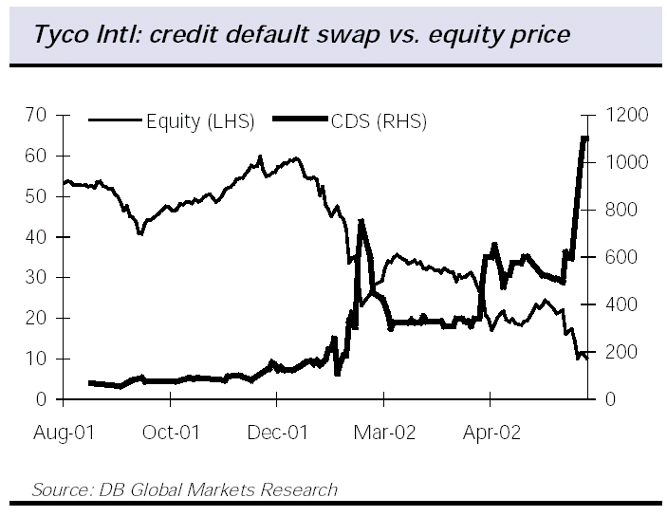
Credit Default Swap III

Slide 42
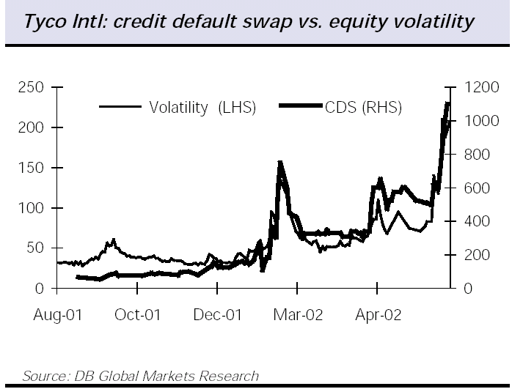
Credit Default Swap IV

Slide 43
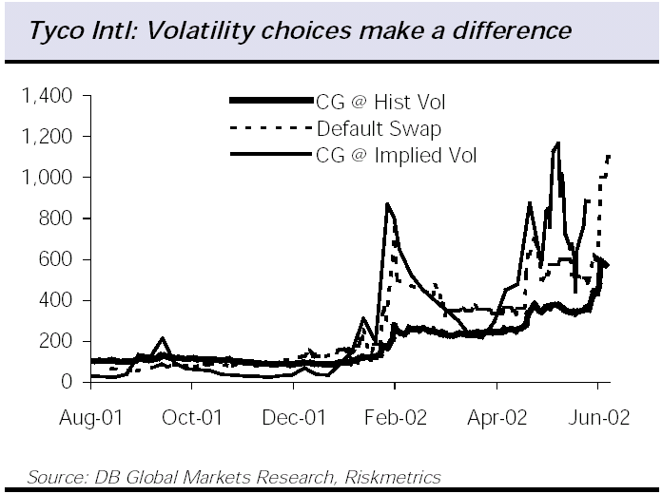
Credit Default Swap V

Slide 44
Spread-Linked Swap
Periodic payments
Party A
Party B
Payments based on spread
B’s payments are based on the credit spread of
a reference security. B may only make a final
payment at maturity based on the credit spread.
A pays LIBOR plus a fixed spread, say.

Slide 45
Default Notes
Default notes: For example, an issuer (credit card company, say) agrees to pay back $100 at maturity and 8% coupons semiannually, but if some default event occurs the coupons drop to 4%.
The investor will pay less than he would for a similar note without credit-linkage in compensation for the option he has sold to the issuer.
Spread-linked notes: Like above, except that here the coupon paid by the investor depends on the credit spread for some reference security.

Slide 46
Levered Notes
For example, corporate bonds might be pooled, and
the cash-flows repackaged in the form of a note that
pays a high (leveraged) coupon in return for accepting
with this the risk that the payments will stop (or be
significantly reduced) if there are one or more defaults
in the pool.
The cash-flows might also be packaged in the form of
lower-yielding money market instruments, thus earning
profits for the issuer (at the cost of accepting some of
the credit risk). In this case, it is the issuer who assumes
the levered position.

Slide 47
Credit Options
Security with the payoff contingent on the
following credit events:
  the price of a reference security drops below
  a strike price (determined by a strike spread),
  the credit spread for a reference security
  tightens or widens, or
  there is a default event of the reference
  entity.

Slide 48
Exotic Variations
Basket credit derivatives (correlation-sensitive products).
Event-contingent option (if a certain project is completed on time, say).
Real options (sell real decision risk instead of market factor risk).
Fixed-income products linked to earthquakes or other catastrophes.
Notes linked to real earnings and inflation (less volatility in real rates).

Slide 49
Types of Risks
Credit risk (obvious) and the price risk (since
this affects profitability, and therefore credit
quality).
Operational risk (contingency planing for
worst-case scenario, for example).
Liquidity risk (can be mitigated by doing
deals back-to-back, and including early
termination provisions).
Legal risk (Orange County).

Slide 50
Benefits from Credit Derivatives
Better serve customer needs.
Diversification of exposures.
Efficient use of balance sheet.
Profiting from market views.
Traders receive information on order flow, customer interest, etc.

Slide 51
Credit Risk: Modelling, Valuation and Hedging
Part 3: Mathematical Modelling
The central point is providing formal quantitative tools to properly serve the purposes listed in Parts 1 and 2

Slide 52

Merton’s Model of Corporate Debt
Let us denote:
V - total value of the firm’s assets,
L - face value of the firm’s debt,
T - maturity of the debt,
- (random) time of default.
Default occurs at time T if the total value of the
firm’s assets at time T is lower than the face
value L of the firm’s debt.

Slide 53

Dynamics of Firm’s Assets
The process representing the total value of the firm’s assets is governed by the stochastic (random) equation:
where is the standard Brownian motion (one-dimensional Wiener process).
The interest rate and the dividend yield are constant.

Slide 54


Merton’s Default Time
The time of default is given by
The recovery payoff at time equals
and thus the corporate bond satisfies

Slide 55

Merton’s Valuation Formula
The price at time of a -maturity corporate bond equals:
where is the time to maturity and

Slide 56
Black and Cox Model
Basic assumptions of Merton’s model are preserved. Value of firm’s assets is lognormally distributed.
The random instant of default is specified as the first moment the value of the firm crosses some barrier: premature default.
The latter assumption is assumed to represent the so-called safety covenants.
Closed-form solution for the value of corporate debt is available (but it is rather involved).

Slide 57
Structural Approach
The total value of the firm’s assets is not easily observed. The total value of shares can be taken as a proxy.
The internal structure of the reference firm is an essential ingredient of the model.
On the other hand, both the cross-default provision and the debt’s seniority structure are relatively easy to cover.

Slide 58
Intensity-Based Approach
Value of the firm is not explicitly modelled.
The intensity of the random time of default
plays the role of a model’s input.
Valuation result for corporate bonds and
credit derivatives are relatively simple, even
in the case of basket credit derivatives.
In practice, the intensity of default can be
inferred from observed prices of bonds
(the calibrated or implied default intensity).

Slide 59
Default Time
Structural approach: is a predictable stopping time with respect to the filtration generated by the value process. Default is announced by a sequence of stopping times.
Intensity-based approach: is a totally inaccessible stopping time with respect to the reference filtration (including the observations of the default time. Default comes as a surprise.

Slide 60
Credit Ratings
Some more recent methods take into account not only the default event, but also the current and futures rating of each firm.
In most cases, the process that models the up/downgrades is a Markov process.
Instead of a default intensity, the whole matrix of intensities of migrations is specified.
Official ratings are given by specialized rating agencies; they do not necessarily reflect (risk-neutral) probabilities of credit migrations.

Slide 61
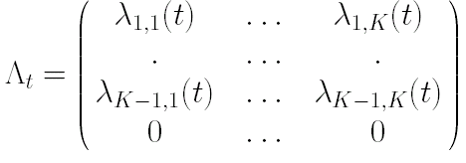
Intensities of Migrations
The matrix of intensities of credit migrations has the following form
where K is the number of credit ratings and the K-th class represents default event. State K is an absorbing state.

Slide 62
References
M. Ammann: Credit Risk Valuation: Methods,
Models, and Applications. Springer 2001.
A. Arvanitis and J. Gregory: Credit Risk:
The Complete Guide. Risk Books 2001.
T. R. Bielecki and M. Rutkowski: Credit Risk:
Modelling, Valuation and Hedging. Springer 2002.
D. Cossin and H. Pirotte: Advanced Credit Risk
Analysis. J. Wiley & Sons 2000.
B. Schmid: Pricing Credit Linked Financial
Instruments. Springer 2002.
D. Duffie and K. J. Singleton: Credit Risk, Princeton
University Press 2003.

Slide 63
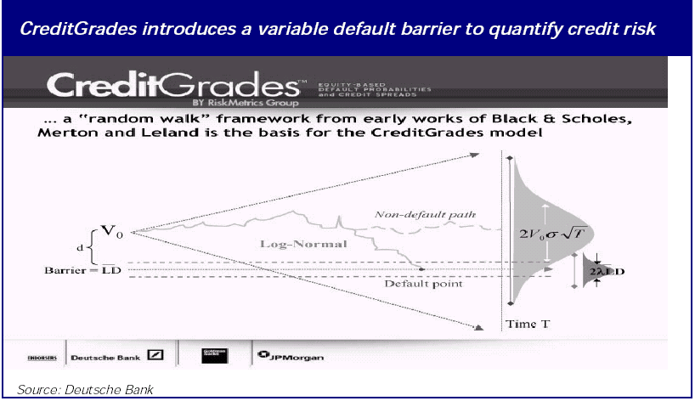
CreditGrades II

